Slide 1



Slide 2


Problem Statement Objective
Continuous improvement is a key focus, with automated model retraining to adapt to evolving fraud patterns .
The overall objective is to foster a secure financial ecosystem, building trust among stakeholders by consistently and effectively identifying and preventing fraudulent activities while minimizing disruptions to legitimate transactions

Slide 3
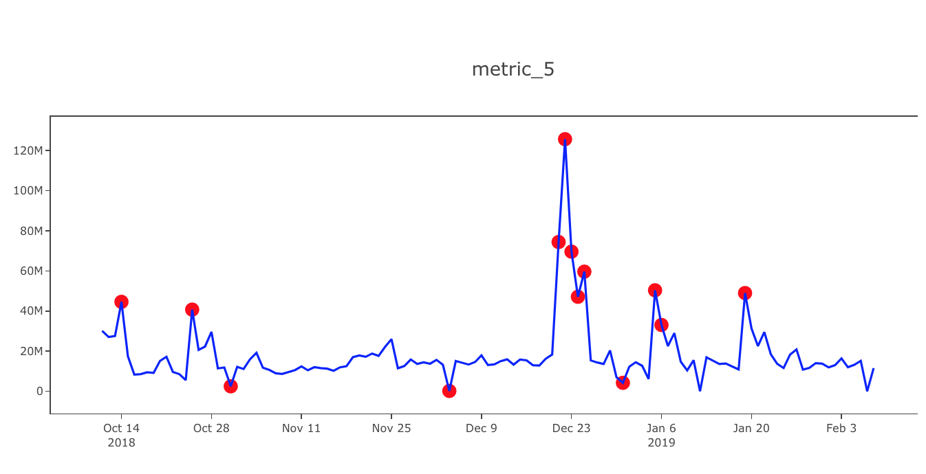
Approach
We have taken provided BAF data of 6 banks which consists of 1000000 people’s financial data.
We have mainly focused on three main pillars of this problem statement :-
1. Data collection and processing
2. Pattern Identification and real time monitoring
3. Visualization
We have trained our model with the most efficient Gradient Boosting Machine (GBM) algorithm which easily identifies fraud in transactions.

Slide 4



Solution
This software is designed to meticulously analyze vast and diverse datasets sourced from various financial transactions.
Real-time monitoring capabilities further enhance its efficacy, allowing for immediate detection and response to suspicious activities as they unfold.

Slide 5

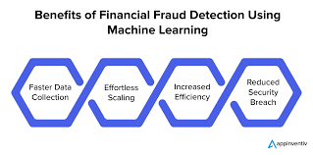
Future Goals
Continuous improvement, marked by automated model retraining and adaptability to evolving fraud patterns, ensures the software remains a vigilant guardian of financial integrity.
The integration of blockchain technology to enhance the security and transparency of financial transactions, making it more challenging for fraudsters to manipulate or exploit vulnerabilities in the system.

Slide 6


Conclusion
As fraud detection software continues to embrace cloud-native architectures and quantum-resistant encryption, it demonstrates a commitment to scalability, security, and long-term resilience.

